Slide 1
Vision Transformers
Sumantrak Mukherjee: 2019A8PS0413P
Preetika Verma: 2019A7PS0088P
Sneha: 2019A7PS0042P
Supervisor: Dr. Surekha Bhanot
TA: Achleshwar Luthra

Slide 2
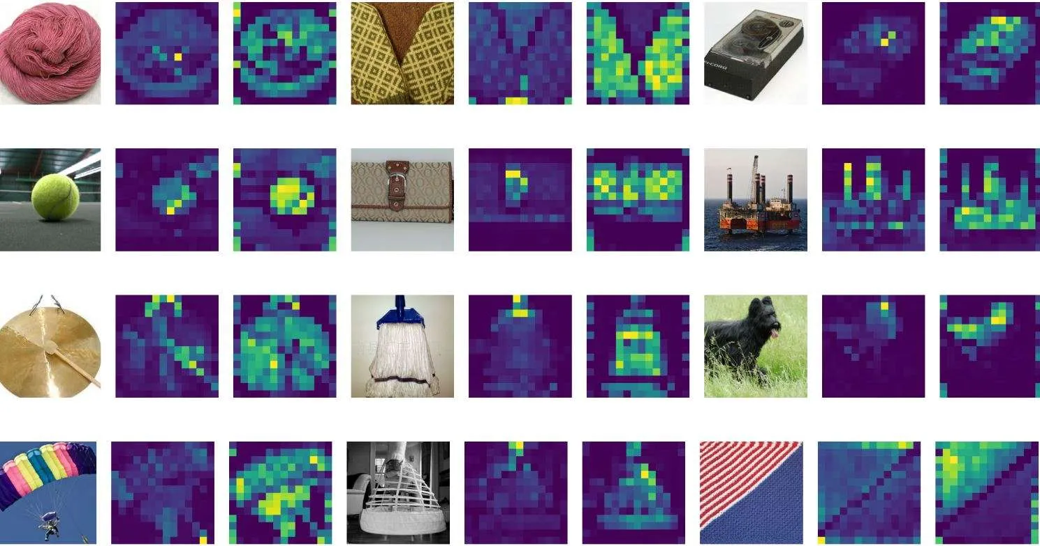
Title and affiliation of authors
Alexey Dosovitskiy -
Lucas Beyer -
Alexander Kolesnikov
Dirk Weissenborn
Xiaohua Zhai
Thomas Unterthiner
Mostafa Dehghani
Matthias Minderer
Georg Heigold
Sylvain Gelly
Jakob Uszkoreit
Neil Houlsby
All authors are affiliated with Google Research, Brain Team.

Slide 3
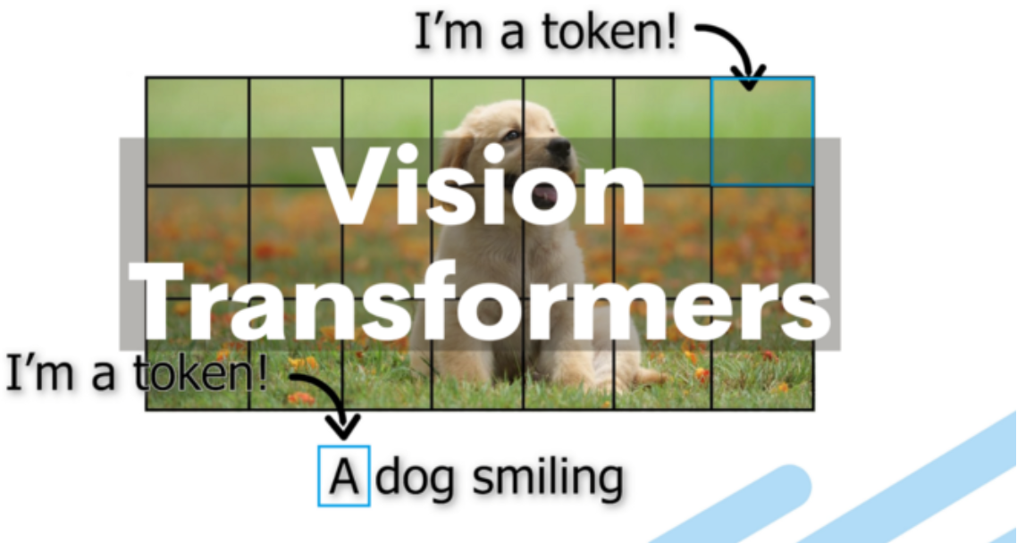
Aim
Applying a pure transformer directly to image classification tasks
Showing that reliance on CNNs is not necessary
Proving that Vision Transformer (ViT) attains better results compared to SOTA convolutional networks while requiring substantially fewer computational resources
to train
Demonstrating its scalability

Slide 4
Methodology
An image is split into a sequence of fixed-size non-overlapping patches.
Flattened patches are linearly embedded
A [CLS] token is added to serve as representation of entire image. This learnable token is used for classification at output.
Absolute position embeddings are added.
Resultant Vector is fed into the Transformer Encoder.
The Transformer encoder consists of alternating layers of Multi-headed Self Attention (MSA) and MLP blocks. Layernorm (LN) is applied before every block.

Slide 5


Slide 6
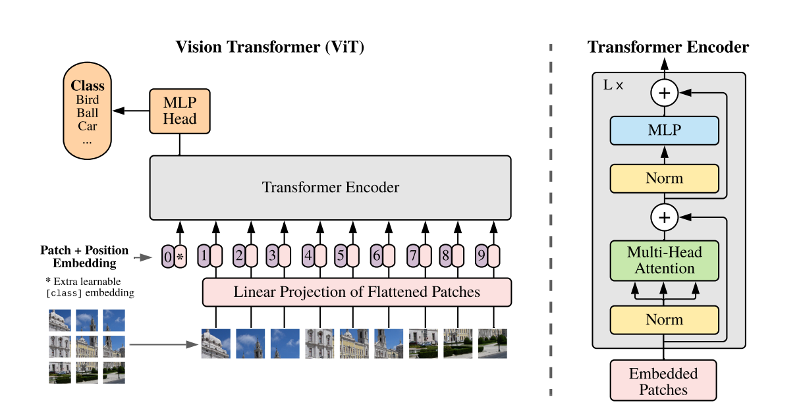
Overview of the Model

Slide 7

Vision Transformer - Working
Flattened 2D patches of fixed size
Patch and Positional Embeddings
Learnable Embedding and Classification Head
Alternating Layers of MSA and MLP

Slide 8
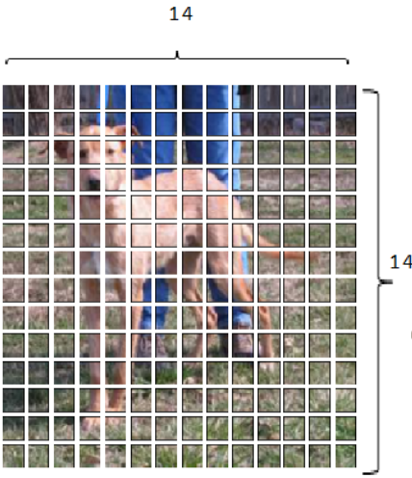
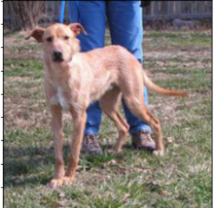
Splitting image into patches
x ∈ R ^{H×W×C} → x_{p} ∈ R ^{N×(P .P ·C)}
(H, W) is the resolution of the original image.
C is the number of channels.
(P, P) is the resolution of each image patch.
N = HW/P² is the resulting number of patches, effective input sequence length
224x224x3
196x(16x16x3)

Slide 9
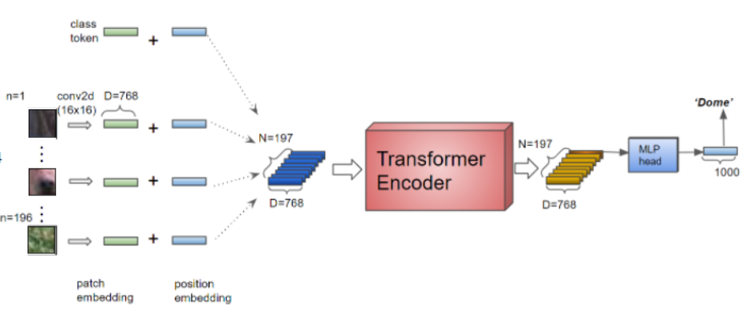
Patch and Positional Embeddings
z₀ = [x_{class}; x¹_{p}E; x²_{p}E; · · · ; x^{N}_{p}E] + E_{pos}
E ∈ R ^{(P .P ·C)×D} is the patch embedding,
E_{pos} ∈ R ^{(N+1)×D} is the positional embedding,
X_{class} is the learnable embedding.
The Transformer uses constant latent vector size D through all of its layers, so we flatten the patches and map to D dimensions with a trainable linear projection.

Slide 10
Structure of Encoder
We prepend a learnable embedding to the sequence of embedded patches (z⁰₀ = x_{class}), whose state at the output of the Transformer encoder (z⁰_{L}) serves as the image representation y.
y = LN(z⁰_{L})
LN is LayerNorm,
L is the total number of layers in the Transformer encoder.
Both during pre-training and fine-tuning, a classification head is attached to z⁰_{L}.
The Transformer encoder consists of alternating layers of multi-headed self-attention (MSA) and multi-layer perceptron (MLP) blocks. LayerNorm (LN) is applied before every block, and residual connections after every block.
z`_{l} = MSA(LN(z_{l-1})) + z_{l-1} l = 1 . . . L
z_{l} = MLP(LN(z`_{l-1})) + z`_{l} , l = 1 . . . L
The MLP contains two layers with a GELU non-linearity.

Slide 11

Transfer learning
Due to computational constraints, we pre-train ViT on large datasets, and fine-tune to (smaller) downstream tasks.
For this, we remove the pre-trained prediction head and attach a zero-initialized D × K feedforward layer, where K is the number of downstream classes.
Datasets Used: ImageNet and Cassava
We have pre-trained our model on ImageNet. We have fine-tuned using a subset of Cassava leaf disease classification dataset.
Notes:
Details about the dataset - Size, features, relevance

Slide 12
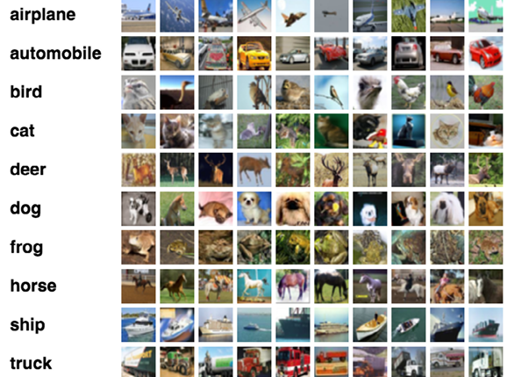
ImageNet - Big Dataset
We used the ILSVRC-2012 ImageNet dataset with 1k classes and 1.3M images.
ImageNet is an image database organized containing more than 14 million images have been hand-annotated by the project to indicate what objects are pictured and in at least one million of the images, bounding boxes are also provided.

Slide 13
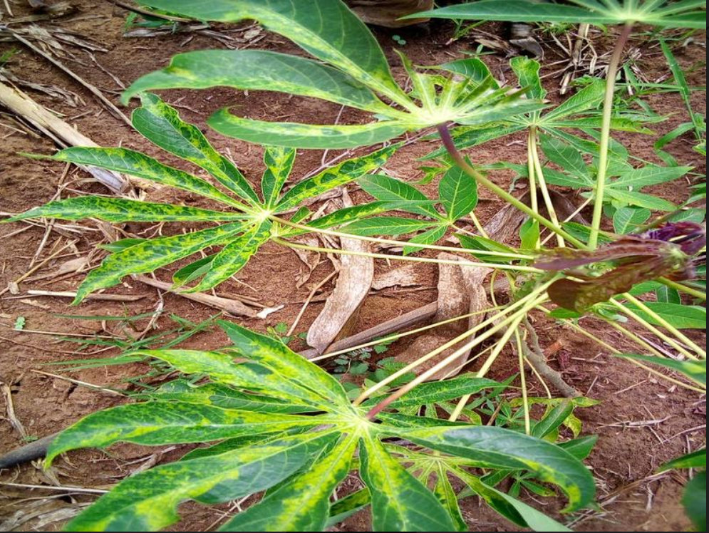
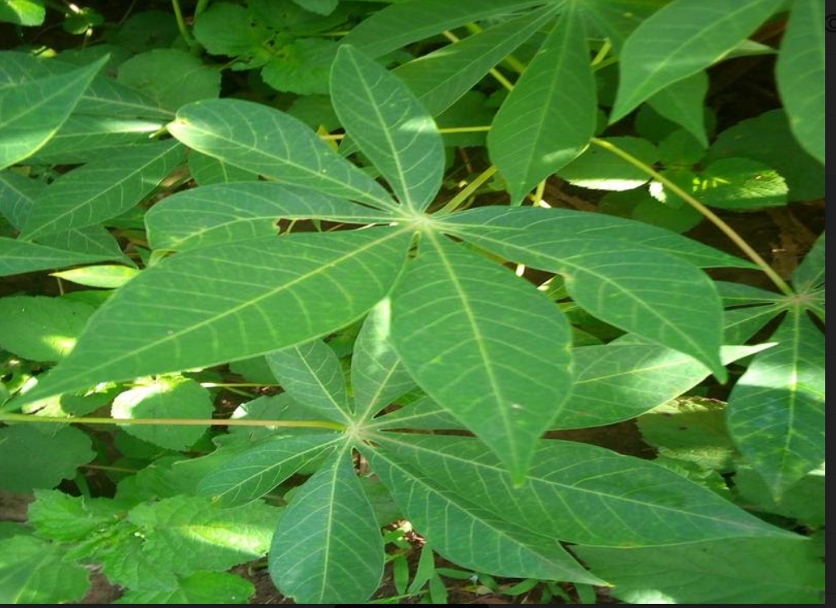
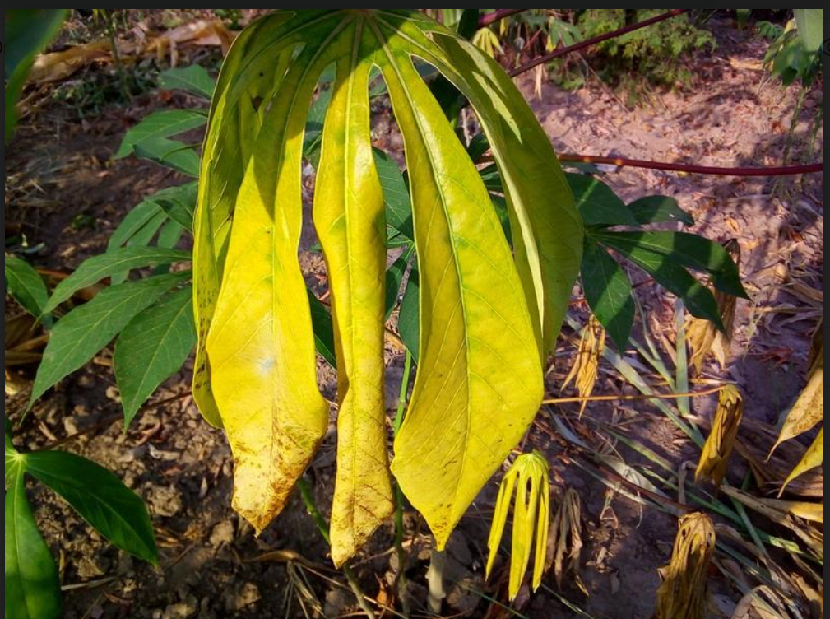
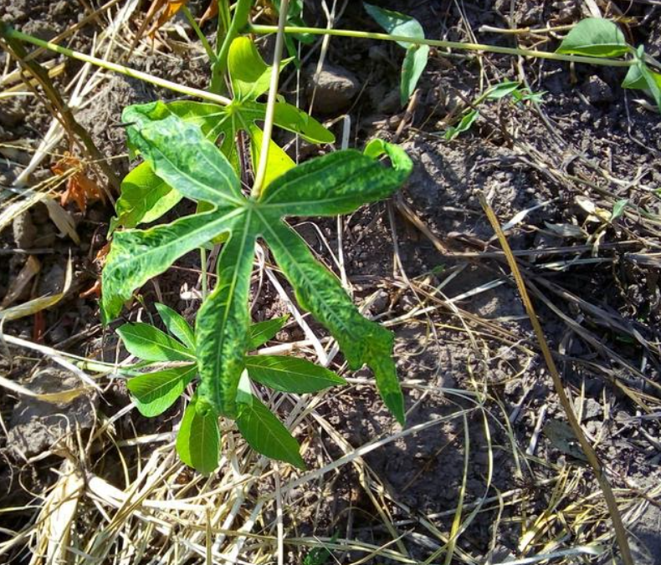
Cassava - Small Dataset (Fine-tuning)
We used the Cassava dataset consisting of a total of 21367 labelled images.
Cassava consists of leaf images for the cassava plant depicting healthy and four (4) disease conditions.
Cassava Mosaic Disease(CMD)
Cassava Bacterial Blight (CBB)
Cassava Green Mite (CGM)
Cassava Brown Streak Disease (CBSD)
Healthy

Slide 15

Implementational Modifications
ImageNet for Pre-Training - It was not practically possible to train the ImageNet dataset on Vision transformer with a single Colab GPU. We defined the architecture and loaded pre-trained weights from the official Github repository.
Cassava Leaf Disease Classification - We fine-tuned on a subset of 1500 images. We used 10% of these for cross-validation. We also reduced the number of classes to 3 instead of 5.

Slide 16

Preprocessing
Train dataset - Normalization
Random transformations - horizontal and vertical flip
Resizing to 224*224
Validation dataset - Resizing to 224*224
Pytorch was used for the code and training time was 55 minutes on Colab GPU.

Slide 17
Model architecture
Patch size is specified as 16 and 196 patches of size 16x16 are obtained from the image.
Number of channels are three. Convolutional 2d layer is used for reshaping the input image as a sequence of flattened patches. Kernel and stride size is 16. We map to 768 dimensions.
We add a learnable embedding to this sequence whose state at output gives us the class.
Position embeddings are added to retain positional information.
Each block of the transformer has Layer Normalization. This is followed by an attention layer with 8 heads. The input is also fed into MLP layer. Outputs from MLP and attention layer are added.
The MLP layer has a linear layer followed by GELU activation. This is again followed by a linear layer.
We use 12 blocks for our implementation. There are residual connections after every block.

Slide 18
Implementation details
Training time - 55 minutes on Colab GPU
Framework used - PyTorch
Number of epochs - 10
Learning rate - 0.001 with scheduling
Optimizer - SGD
Loss function - Cross-entropy loss
Batch size - 16
Training accuracy after 10 epochs - 86.888
Validation accuracy after 10 epochs - 82.00

Slide 19
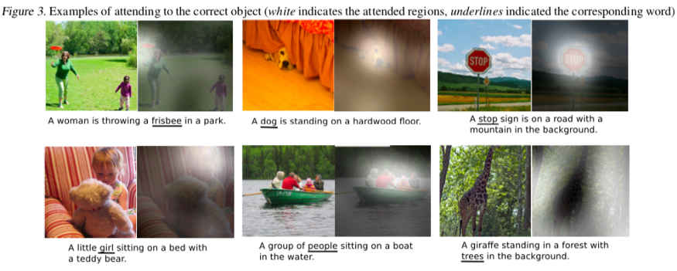
Attention is all you need!
Attention in layman terms is the process of selectively concentrating on a few things while ignoring other aspects.
Takes in an input of size n and gives out an output of size n. Uses Key, Query and Value matrices.

Slide 20
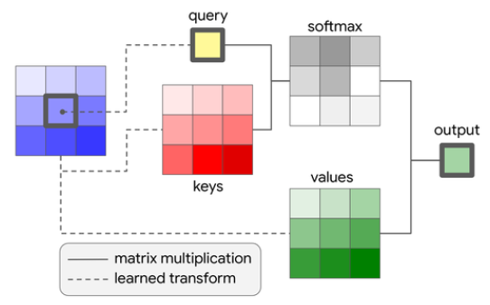
Implementation: Attention
We have 4 image patches A,B,C and D.
To calculate the Context vector for D, the operations would be multiplying the Query(D) with the Key vectors of A,B,C.
Then, we perform a softmax operation on resultant vector.
After the softmax operation, we get the values [0.2,0.3.0.5].
For calculating the context we use 0.2*V_A + 0.3*V_B + 0.5*V_C.

Slide 21
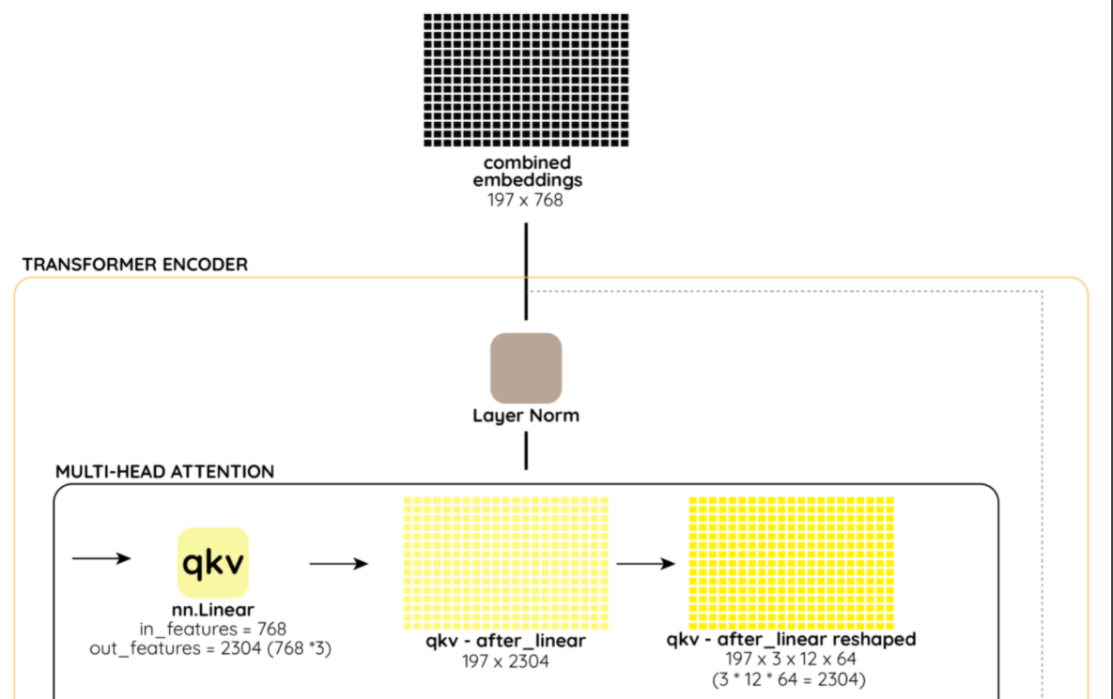
197x2304
197x3x8x96
(3*12*64=2304)

Slide 22
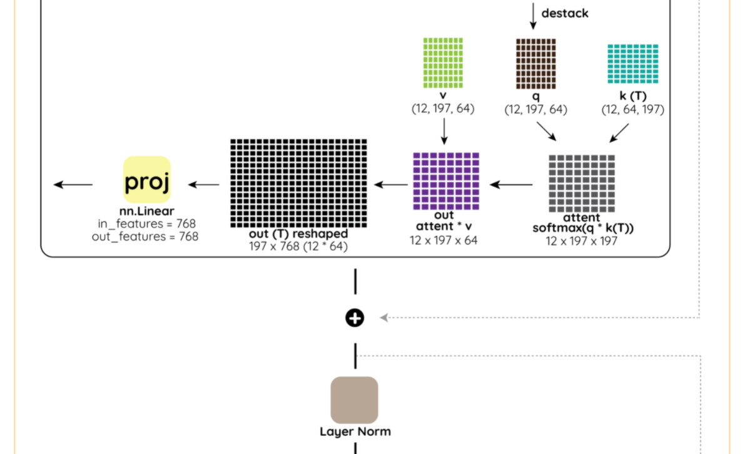

Slide 23
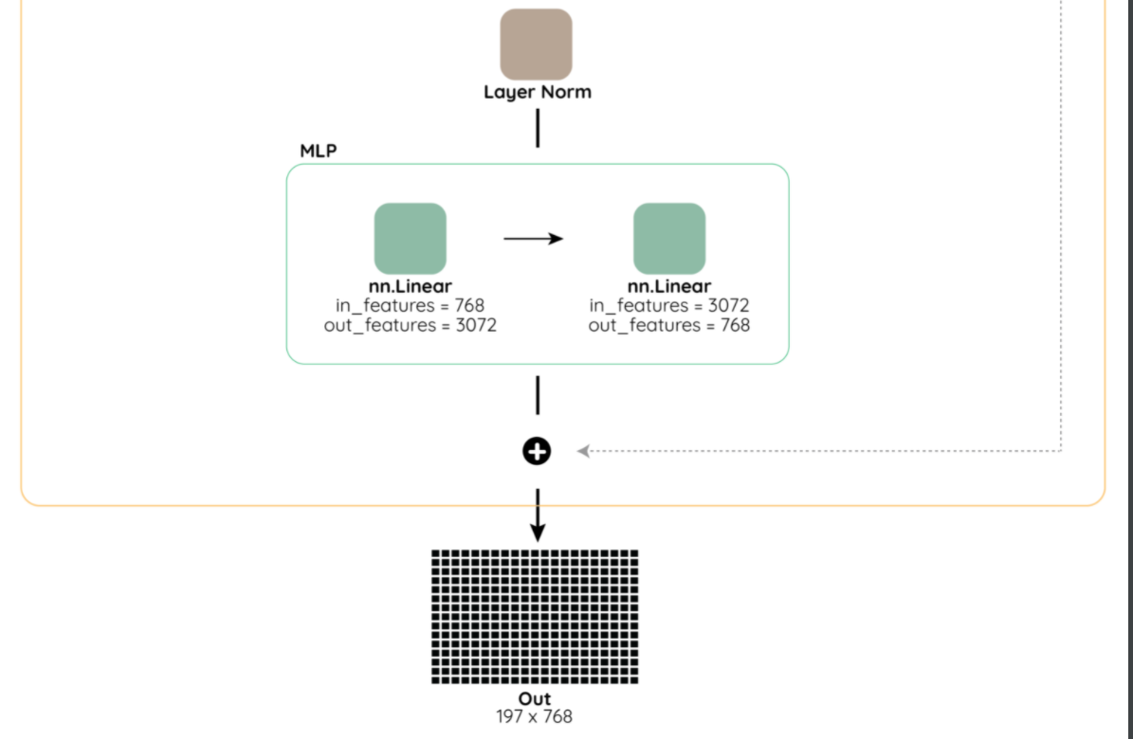

Slide 24
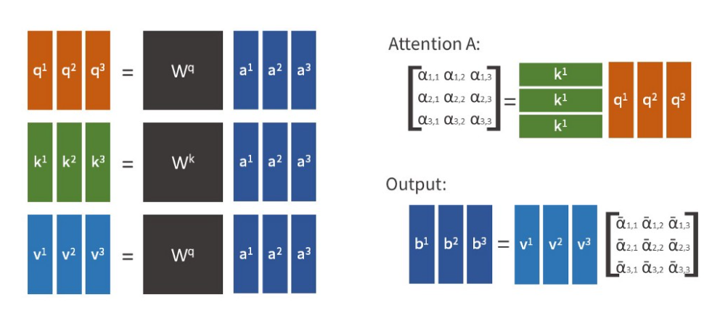
Self-Attention
Self-Attention (SA): For each element in an input sequence z ∈ R ^{N X D} we compute a weighted sum over all values v in the sequence. The attention weights A_{ij} are based on the pairwise similarity between two elements of the sequence and their respective query q^{i} and key k^{j} representations.
Multihead self-attention (MSA) is an extension of SA in which we run k self-attention operations, called “heads”, in parallel, and project their concatenated outputs.

Slide 25
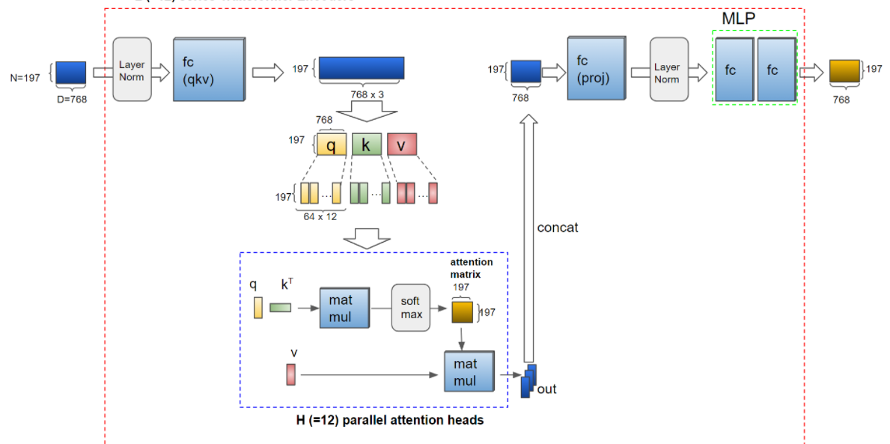
96 x 8
(=8)

Slide 26
Results
Using the ViT model, we have explored the direct application of Transformers to image recognition.
Unlike prior works using self-attention in computer vision, we do not introduce image-specific inductive biases into the architecture apart from the initial patch extraction step. Instead, we interpret an image as a sequence of patches and process it by a standard Transformer encoder as used in NLP.
This simple, yet scalable, strategy works surprisingly well when coupled with pre-training on large datasets.
Thus, Vision Transformer matches or exceeds the state of the art on many image classification datasets, whilst being relatively cheap to pre-train.

Slide 27
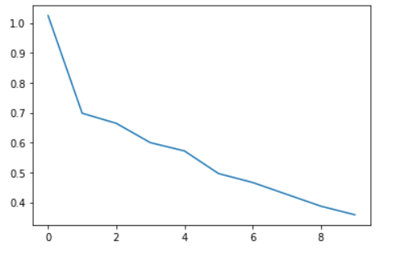
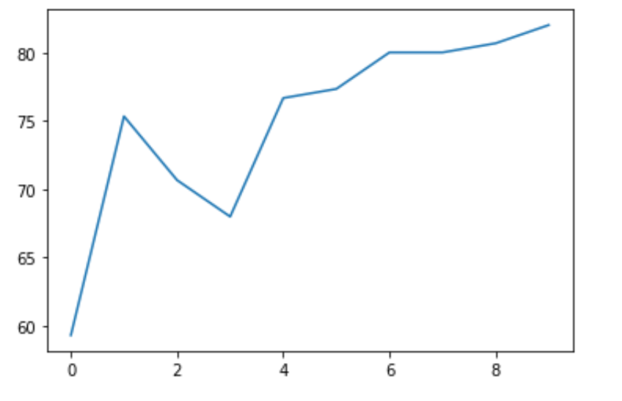
Results: Loss
Training Loss
Validation loss

Slide 28
Future scope
The follow-up works that have been made on Vision transformers are very encouraging. They include -
Applying ViT to other computer vision tasks, such as detection and segmentation.
DINO (a method for self-supervised training of Vision Transformers) by Facebook AI. DINO models are capable of segmenting objects, without having ever been trained to do so.
Further scaling of ViT would likely lead to improved performance.
ViT models haven’t shown any signs of saturating performance yet.
Zero-shot learning

Slide 29
Thank You!

